Slide 1
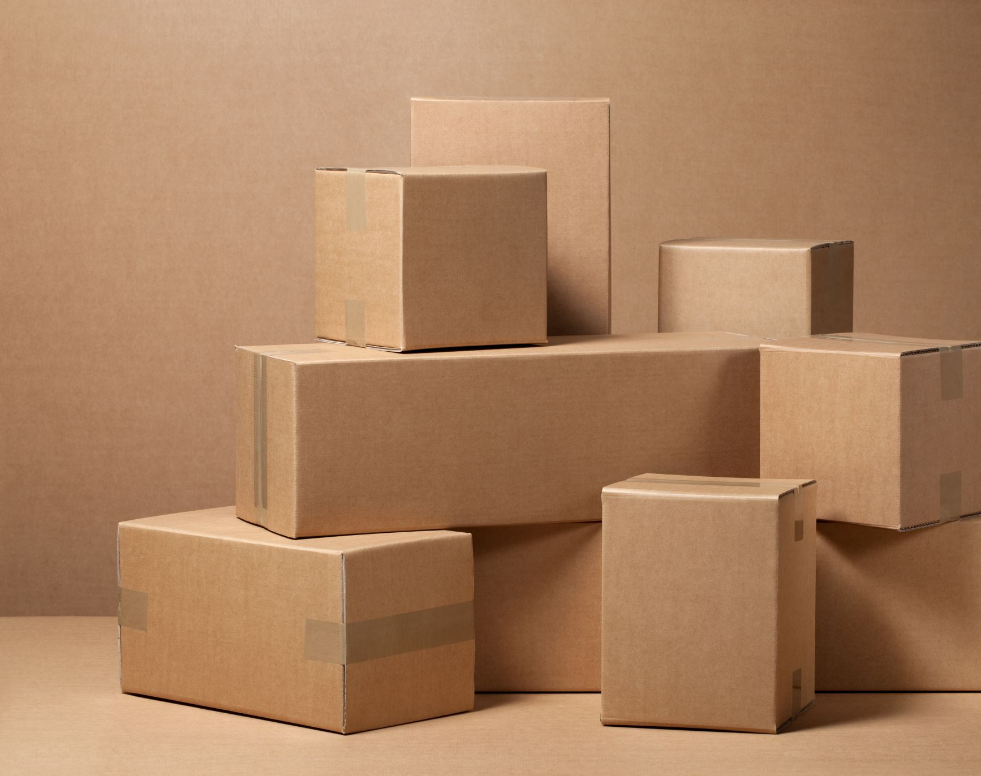
Place (aka Distribution)
Lecture 8

Slide 2
Marketing Channels: Delivering Customer Value
Chapter 12

Slide 3
Learning Objectives
12.1 Explain why companies use marketing channels and discuss the functions these channels perform.
12.2 Discuss how channel members interact and how they organize to perform the work of the channel.
12.3 Identify the major channel alternatives open to a company.
12.4 Explain how companies select, motivate, and evaluate channel members.

Slide 4
Supply Chains and the Value Delivery Network LO12.1 Explain why companies use marketing channels and discuss the functions these channels perform.
Upstream partners are firms that supply raw materials, components, parts, information, finances, and expertise needed to create a product or service.
Downstream partners include the marketing channels or distribution channels that look toward the customer, including retailers and wholesalers.
Supply chain “make and sell” view includes the firm’s raw materials, productive inputs, and factory capacity.
Demand chain “sense and respond” view suggests that planning starts with the needs of the target customer.
Value delivery network is composed of the company, suppliers, distributors, and, ultimately, customers who partner with each other to improve the performance of the entire system.

Slide 5
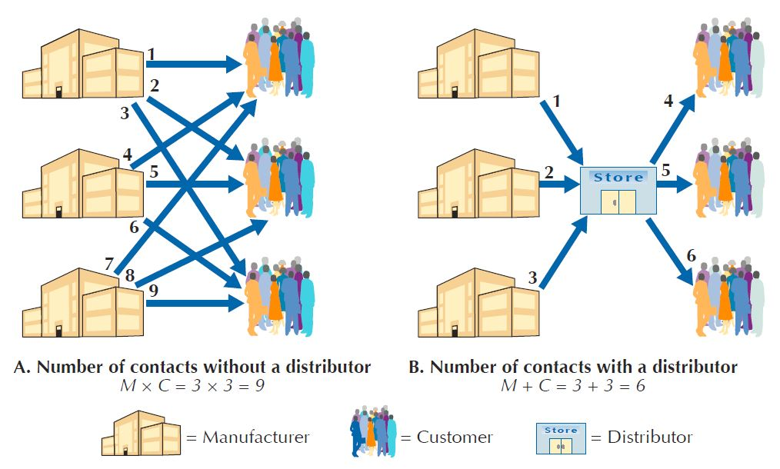
The Nature and Importance of Marketing Channels
Marketing channel (distribution channel) is a set of interdependent organizations that help make a product or service available for use or consumption by the consumer or business user.
How Channel Members Add Value
Transform the assortment of products into assortments wanted by consumers
Bridge the major time, place, and possession gaps that separate goods and services from users
Reduce the number of channel transactions

Slide 6
The Nature and Importance of Marketing Channels
How Channel Members Add Value
Information
Promotion
Contact
Matching
Negotiation
Physical distribution
Financing
Risk taking

Slide 7
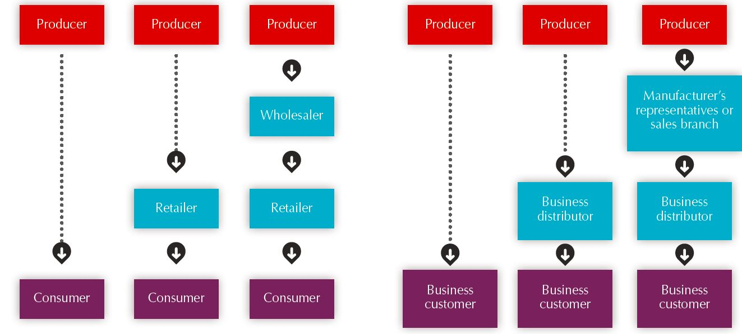
The Nature and Importance of Marketing Channels
Number of Channel Levels : Consumer and Business Marketing Channels

Slide 8
The Nature and Importance of Marketing Channels
Number of Channel Levels
Connected by several types of flows
Physical flow of products
Flow of ownership
Payment flow
Information flow
Promotion flow

Slide 9
Channel Behavior and Organization LO12.2 how channel members interact and how they organize to perform the work of the channel.
Channel Behavior
Marketing channels consist of firms that have partnered for their common good with each member playing a specialized role.
Channel conflict refers to disagreement among channel members over goals, roles, and rewards.
Horizontal conflict - occurs among firms at the same level of the channel. For instance, some Toyota dealers in one territory might complain that dealers in another steal sales from them by pricing too low or by advertising outside their assigned territories.
Vertical conflict - conflict between different levels of the same channel, is even more common. For example, United Airlines tried to stimulate sales by selling directly to consumers in Hong Kong—it gave significant mileage bonuses and price discounts directly to them without proper coordination with Hong Kong travel agents. The travel agents protested by refusing to sell United Airlines tickets. Seeing the dramatic decline in sales, United Airlines reverted to the previous agent distribution system.

Slide 10
Marketing Channel Choice and Management Managing Channel Relationships
Sources of channel conflict
arises when one channel member believes another channel member is engaged in behavior that prevents it from achieving its goals.
Vertical conflict
Occurs between different levels in a marketing channel, such as a manufacturer and a retailer.
Three sources of vertical conflict are:
Disintermediation is channel conflict that arises when a channel member bypasses another member and sells or buys products direct.
Conflict over how profit margins are distributed among channel members.
When manufacturers believe wholesalers or retailers are not giving their products adequate attention.
Horizontal conflict
Occurs between intermediaries at the same level in a marketing channel such as between two or more retailers or two or more wholesalers who handle the same manufacturer’s brands.
Two sources of horizontal conflict are:
When a manufacturer increases its distribution coverage in a geographical area.
when different types of retailers carry the same brands, which sometimes occurs in dual distribution situations.

Slide 11
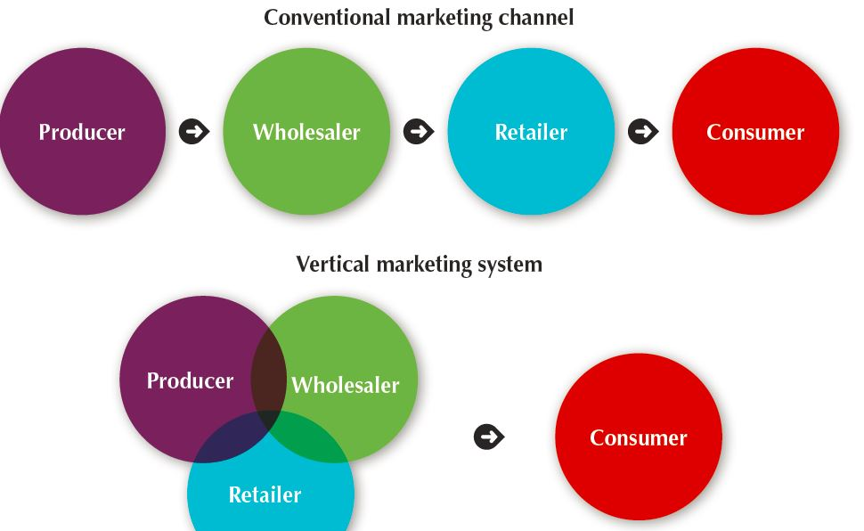
Channel Behavior and Organization
Vertical Marketing Systems
Conventional distribution systems consist of one or more independent producers, wholesalers, and retailers, each separate business seeking to maximize its own profits, perhaps even at the expense of profits for the system as a whole.

Slide 12
Channel Behavior and Organization
Vertical Marketing Systems
Vertical marketing systems (VMSs) provide channel leadership and consist of producers, wholesalers, and retailers acting as a unified system.
Corporate marketing systems - combine successive stages of production and distribution under single ownership. (example, Apple)
Contractual marketing systems - consist of independent firms at different levels of production and distribution who join together through contracts.
Franchise organization is a contractual vertical marketing system in which a channel member, called a franchisor, links several stages in the production-distribution process.
Almost every kind of business has been franchised—from hotels and fast-food restaurants to kindergartens and fitness centers. (examples, McDonalds, Burger King)
Administered marketing systems - coordinates successive stages of production and distribution through the size and power of one of the parties. (example, Wal-mart)

Slide 13
Channel Behavior and Organization
Horizontal Marketing Systems
Horizontal marketing system is a channel arrangement in which two or more companies at one level join together to follow a new marketing opportunity.

Slide 14
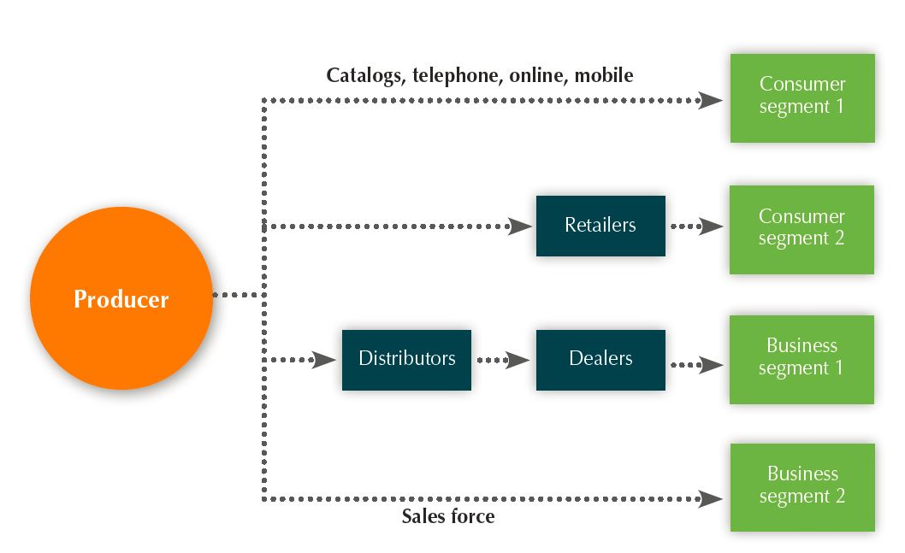
Channel Behavior and Organization
Multichannel Distribution Systems
Multichannel distribution systems are systems in which a single firm sets up two or more marketing channels to reach one or more customer segments.

Slide 15
Channel Design Decisions LO12.3 Identify the major channel alternatives open to a company.
Analyzing consumer needs
Setting channel objectives
Identifying channel alternatives
Evaluating channel alternatives

Slide 16
Channel Design Decisions
Analyzing Consumer Needs
Find out what target consumers want from the channel
Identify market segments
Determine the best channels to use
Minimize the cost of meeting customer service requirements

Slide 17
Channel Design Decisions
Setting Channel Objectives
Determine targeted levels of customer service
Balance consumer needs against costs and customer price preferences
Identifying Major Alternatives
Types of intermediaries refers to channel members available to carry out channel work. Most companies face many channel member choices.

Slide 18
Channel Design Decisions
Identifying Major Alternatives
Number of Marketing Intermediaries
Intensive distribution
Exclusive distribution
Selective distribution

Slide 19
Exclusive Distribution
Exclusive distribution means severely limiting the number of intermediaries.
It is used when the producer wants to maintain control over the service level and outputs offered by the resellers.
Often it involves exclusive dealing arrangements.
By granting exclusive distribution, the producer hopes to obtain more dedicated and knowledgeable selling.
It requires greater partnership between seller and reseller and is used in the distribution of new automobiles, some major appliances, and some women’s apparel brands.

Slide 20
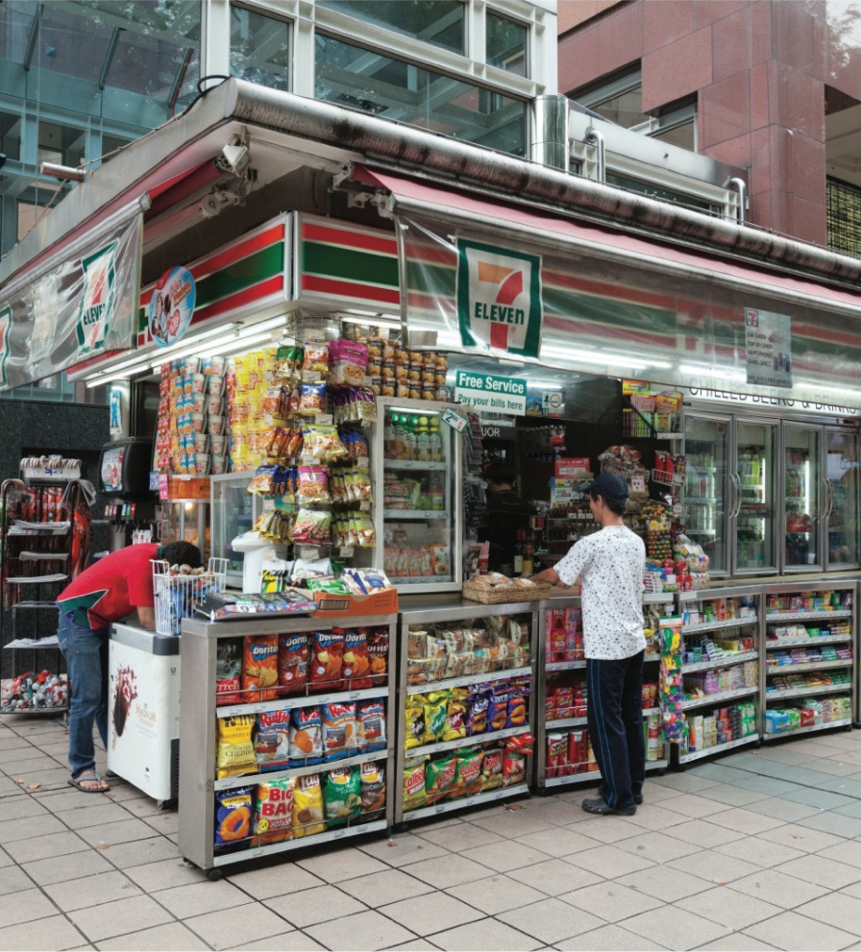
Intensive Distribution
Intensive distribution places the goods or services in as many outlets as possible.
This strategy is generally used for items such as tobacco products, soap, snack foods, and gum—products for which the consumer requires a great deal of location convenience.
Example: 7-Eleven stores

Slide 21

Selective Distribution
Selective distribution relies on only some of the intermediaries willing to carry a particular product.
It is used by established companies and by new companies seeking distributors.
The company does not have to worry about too many outlets; it can gain adequate market coverage with more control and less cost than intensive distribution.
Eg: Where a brand or company only has limited outlets (for some 2-3 outlets (Gucci, LV), Hour Glass (Patek Phillipe, Rolex, IWC) or others 4-5 outlets (Zara) )

Slide 22

Channel Design Decisions
Identifying Major Alternatives
Responsibilities of Channel Members
A producer and the intermediaries need to agree on
Price policies
Conditions of sale
Territory rights
Specific services
Evaluating the Major Alternatives
Economic criteria
Control issues
Adaptability criteria
Designing International Distribution Channels
Channel systems can vary from country to country.
Marketers must be able to adapt channel strategies to structures within each country.

Slide 23
Channel Management Decisions
Selecting channel members
Managing channel members
Motivating channel members
Evaluating channel members

Slide 24
Channel Management Decisions
Channel Member Selection
Ease varies by manufacturer reputation & market power
Good middleman’s qualifications:
Experience
Cooperativeness
Size
Clientele
Location
Other lines carried
Growth & profit record
Reputation
Service level
Managing Channel Members
Practice partner relationship management to forge long-term relationships with channel members
Convince distributors that they can succeed by working together as part of cohesive delivery system

Slide 25
Channel Management Decisions
Channel Motivation
Power: Ability to get another to do what s/he would not otherwise do
Economic sources
Reward Power (margins, allowances, deals)
Social sources
Expertise (distribution programming)
Legitimacy (franchises, ownership)
Evaluating Channel Members
Requalify intermediaries and prune the weaker ones
Recognise and reward intermediaries that have performed well and adding good value to consumers
Underperformers to be assisted or replaced

